Slide 1

Grammar Focus: passive (2) in Present perfect and past perfect

Slide 2
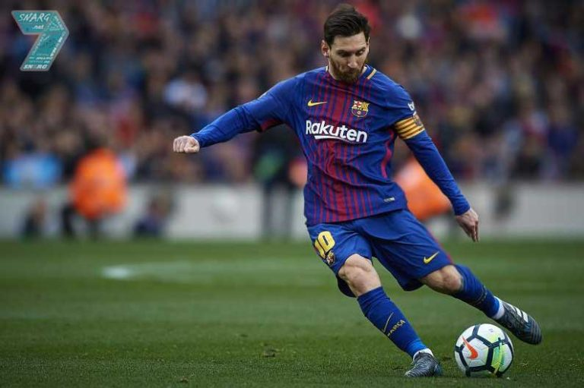
A. Passive voice is used when we only focus on the event not the subject who does it
Active : Messi is kicking the ball.
Passive : The ball is being kicked by Messi.

Slide 3

B. Passive voice is used to avoid the subject
Active : Lisa cleans the glass.
Passive : The glass is cleaned.

Slide 4
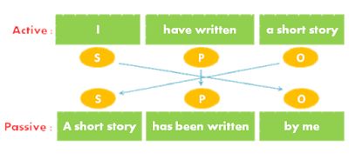
Passive in present perfect
Passive form in Present Perfect : S + have/has + been + V3
Example: - English has been studied by us for a year
The music has been listened by him for an hour
A letter has been sent by her

Slide 5
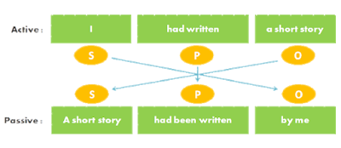
Passive in Past perfect
Passive form in Past Perfect : S + had + been + V3
Example: - The bad news had been heard by her
A mistake had been made by him
English had been studied by me

Slide 6
Exercise
Change the sentences to passive voices
1. The government has built three parks.
_______________________________________
2. The students had written the essays.
_______________________________________
3. Tom had recommended new places.
_______________________________________
4. Three horses were pulling a wagon.
_______________________________________
5. Alex was drinking a cup of coffee.
_______________________________________
6. The worker is cleaning those windows.
_______________________________________
7. Mr. Smith has signed the document.
_______________________________________
8. Waiters are serving customers.
_______________________________________
9. Jane has taken English course.
_______________________________________
10. My secretary has sent those emails.
_______________________________________

